Slide 1
Stereo Vision and Collison Avoidance (Simon)
Improvement of Stereo Camera System
Implementation of Collision Avoidance with Tentacles

Slide 2
Stereo Vision - Planned Steps
Refactor existing code to use OpenCV 3.1.0
Improve stereo camera image quality
Either with hardware synced cameras or
Single Camera with mirrors/prism to create stereo vision

Slide 3
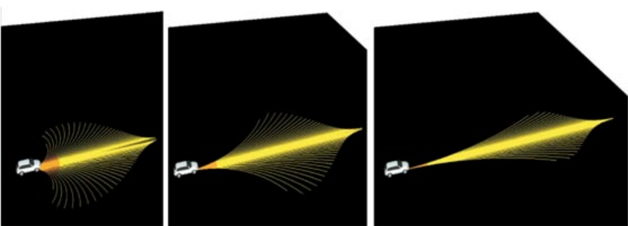
Collision Avoidance - Planned Steps
Use Tentacle algorithm for path planning

Slide 4
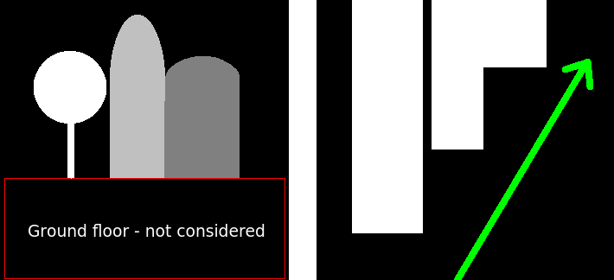
Collision Avoidance - Planned Steps
Use Tentacle algorithm for path planning
Avoid collision by using top view depth map

Slide 5
Collision Avoidance - Planned Steps
Use Tentacle algorithm for path planning
Avoid collision by using top view depth map
Return possible steering angles to the drive logic

Slide 6
Current Progress
100%
50%
33%
Refactor and improve current StereoVision code
Improve stereo camera image quality
Hardware synced PS3 Eye camera prototype
Install cameras to car
//TODO: Falls hardware sync geht, hier das ergebnis!
Collision Avoidance using Tentacles
Tentacle algorithm implemented by Roger
TODO: plug into the Stereo Vision Module
TODO: test algorithm and variables for reliable avoidance

